Slide 1
Happy 20th Birthday CH International & Welcome to the Yearly Conference Dubai - Oct. 2017

Slide 2
Without our People we would be just a network of Accountants. Thank you Friends
It is hard to imagine how the founders of CH International envisaged the future of their Association back when, 20 years ago, they first embarked on their venture.
Yet behind the hard, day-to-day work there was a dream which did not presage everything created to date, and the realization that the Association is still in the midst of an expansion phase. This process and the journey undertaken are guided in a way that ensures everyone is involved: Members, Members’ staff and Customers alike.
Those working with CH International know they are part of something special. CH International is the sum of its resources: an Association which is built upon, and identifies with, its manpower. Empowerment, determination, energy and passion: this is what everyone is offered. It is a challenge, but it is the most practical way of providing a response to those looking for development, and for those who believe in a Network which is looking to the future.
Those working with CH International are well aware that they are part of a story still being written, part of a challenge which has only been underway for twenty years, and which still has to tackle its finest, most intense tasks.

Slide 3
What has been done: New Members
During this intense period, the Board has met 3 times and has continued their discussion, almost weekly, to organize and develop the network.
First and foremost, they have continued to search for new members in countries where we are not yet present.
During the year, Portugal, represented by Andrew Kennard (from HK Consulting, with offices in Lisbon and the Algarve), has come on board and become an “active party” from the get-go.
Then RV Consulting Ltd from Mauritius joined our Network too.
Vicky Ramdane is the point of contact for CH International. The office is located in Laborde Street Bois Rouge Pamplemousses +230 Mauritius.

Slide 4
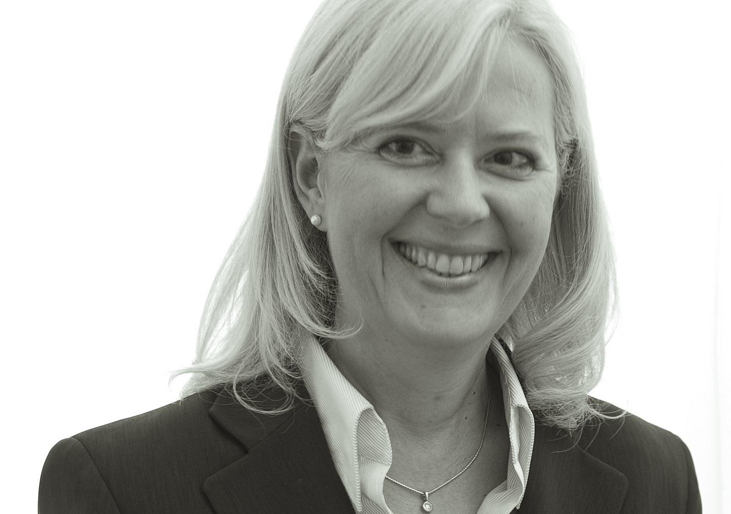
What has been done: New Members
And last but not least, a new member from Germany - a strategic Country - has come on board as well; DFFK, kröller + partner mbB Steuerberatungsgesellschaft (www.dffk.de), located in Stuttgard, joined CH International since August 2017.
Elke Fischer is the point of contact for CH International. The office is located in Stuttgart Schickhardtstraße 57. All details are shown in our web site.

Slide 5
What has been done: Prospective Members
The Board is still continuing to look for new Countries such as US, Poland, Russia and Africa and in countries where members have moved on, for one reason or another. In fact, we are in progressed discussions with:
A firm in Russia, highly recommended by the Cicero member there
A firm in Bulgaria, who Graham will go and meet on November 1st along with the Cicero member (to ensure that a good relationship is also established with our legal friends)
A firm in Malta, recommended by our former member, Charles Scerri, who has informed us they would like to join
The contact recommended to us by Cicero in Poland has decided now is not the right time for their newly established business to join but they have been giving and receiving referrals with CH International. Our hunt goes on!

Slide 6
What has been done: Cooperation partners
Cicero:
The relationship with Cicero goes from strength to strength. There is a feeling that our groups are becoming closer, with more people attending each other’s meetings and yet more assistance to secure new member countries. We thank our friends at Cicero wholeheartedly for their help.
As far as we have been notified, there have been at least four work referrals from CH International to Cicero this year – between our Lithuanian members, our Italian and Cicero’s Turkish member and our UK and Cicero’s Irish member. The Irish job will produce a substantial fee, anticipated around €70,000 – from a large UK client acquiring an Irish business. Our David Gorman should also benefit from a very good fee for the financial due diligence!

Slide 7
What has been done: Cooperation partners
SMS Latinamerica:
SMS is continuing in a really good way and some referrals have been performed in the last year. Andrew Kennard from HK Consulting in Portugal has been busy since he joined our association, not only referring to our members, but also to SMS in Costa Rica, Peru and Brazil. Thank you Andrew, for getting stuck straight in!
I have also referred a tender opportunity to SMS Chile.
SMS Argentina have referred a client to CHI UK and CHI Spain and Israel (Luis and Maor are working together on this).
It is very encouraging that we are supporting each other on these different levels, most importantly in supporting our clients.

Slide 8
What has been done: Referrals update
There have been 32 referrals and advice requests in the year to date, between CH International members and also with our cooperation partners.
That compares with 29 in 2015 and 23 in 2016.
We will keep up the good work in promoting our association and thinking of our colleagues when our clients need trusted advisors.
Thank you all for your trust and commitment ☺

Slide 9
What has been done: New initiatives
The foundation of the first “Technical Group” on the subject of VAT, for which Charles Green (UK) has been named President; Paolo, Martin, Kjetil, Kristina, Luis, Magnus from the group are involved. I will hand over to Charles for a brief update.
The second “Technical Group” on the subject of Audit should start pretty soon.
The creation of the “magazine” Food for Thought; an idea incubator aimed at being a trampoline for new local business initiatives for every member of the network, as well as a common ground connecting all of us.

Slide 10
What has been done: New initiatives
The Staff Exchange Program among various network members started in September when Ulyana Bazyuk from Czech Republic spent 3 weeks in Milan to develop the international experience between members. Monika will say a few words about Uli’s and their firm’s experience of this exchange.
Besides Kjetil Haug from Norway should start his exchange program in Milan for 2 week in January 2018.

Slide 11
What has been done: New initiatives
The first One to One Business Support Clinic started in October when Italy and Portugal met each other to gain and understanding their business, services offering, client profiles, etc. It was the opportunity to share ideas for increasing business efficiency, effectiveness and growth. Andrew will now say a few words about the experience from his point of view.
If anyone would like to attend the same meeting just share with the board.

Slide 12
What has been done: New activity
CH International is now a member of the International Trade Council and have had the opportunity to feature prominently in their ‘2017 Global Business Confidence Survey’, where we have provided introductory commentary to the results and featured an advert.
The survey measures business confidence, challenges and innovations for the coming 12 months and the survey results were shared with the governments of 191 countries, 1318 Chambers of Commerce, 499 industry associations and directly emailed to 1,221,954 CEO’s from a wide range of industries.
This survey has just been published and we will share it with you all!
A Director at the Trade Council also referred a billion dollar enterprise with operations across the Middle East and Africa to Clarkson Hyde in the UK for an introduction to an appropriate Barclays Bank contact. There will also be the possibility for Clarkson Hyde to assist the client with their UK accounting requirements.

Slide 13
The brand CHI
Promoting the CH International brand in each Country
Italy re-branded completely their own practice into Clarkson Hyde Italy and S&V Asesores Financieros have come to the decision to rebrand to Clarkson Hyde Spain.
The new re-branding is allowing them to grow their market perception in the respective Countries.

Slide 14
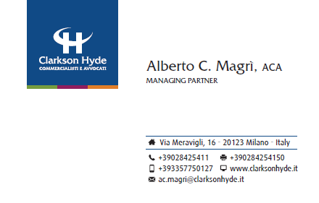
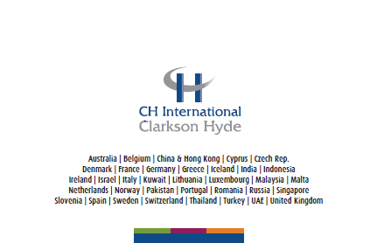
The brand CH International
Example of the new business card:
Promoting the CHI brand in each Country

Slide 15
Relationship: a Key of success
Take risks for big results
It is not easy to leave your comfort zone but so rewarding
Watch this great John Maxwell message:
http://johnmaxwellteam.com/2017-DARING

Slide 16
Thanks to…
I would like to thank the CHI board for the support gave to me in this exciting year. I have been proud of being the President this Year. It was an honor for me.
Graham, Luis, Martin, Claire and Carly needed a lot of patience to put up with me in this year. Thank you so much, my Friends. I’ve learned a lot from each of you and I am so thankful because you contributed to help me to move on to my next step.
Imagination is everything and it is more important than knowledge, as Albert Einstein said. But to move from Imagination to reality we need the support and the trust of each of CH International member, also through Innovation which when it comes is a dream which gets us ahead.

Slide 17
Thank you so much for your attention.
Alberto C. Magrì
Board President 2016/17

